Slide 1



PART 2

Slide 2
Emag spectrum characteristics

Slide 3
TYPICAL ENERGY RANGES

Slide 4
EXAMPLE 1
A particular event produced radiation with an energy of 100 kev
WHAT IS ITS FREQENCY?
WHAT IS ITS WAVELENTH?
WHAT IS ITS LIKELY SOURCE?

Slide 5
CORRELATION OF CHARGED PARTICLE FLUX DENSITY WITH SOLAR ACTIVITY

Slide 6

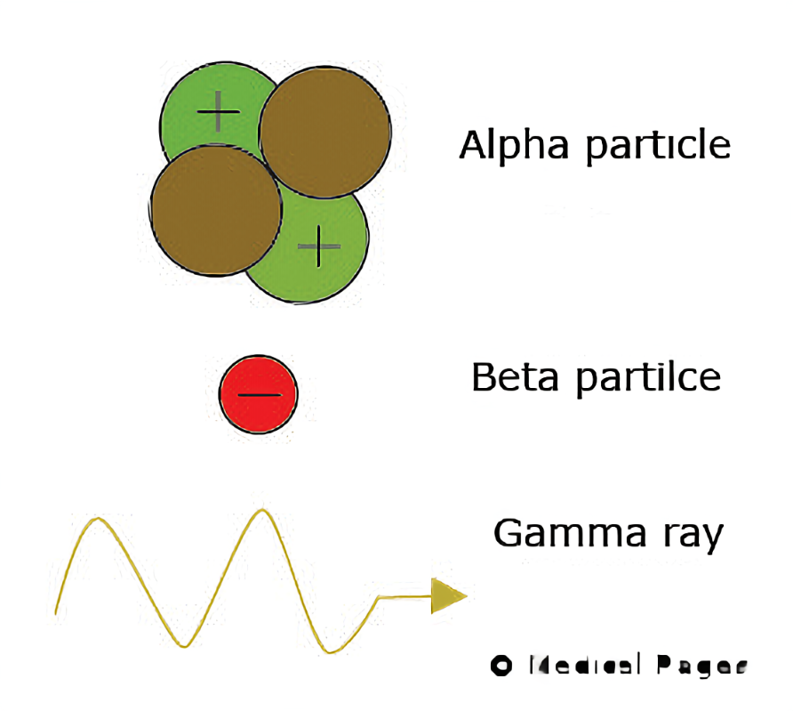
RADIOACTIVE SUBSTANCES

Slide 7
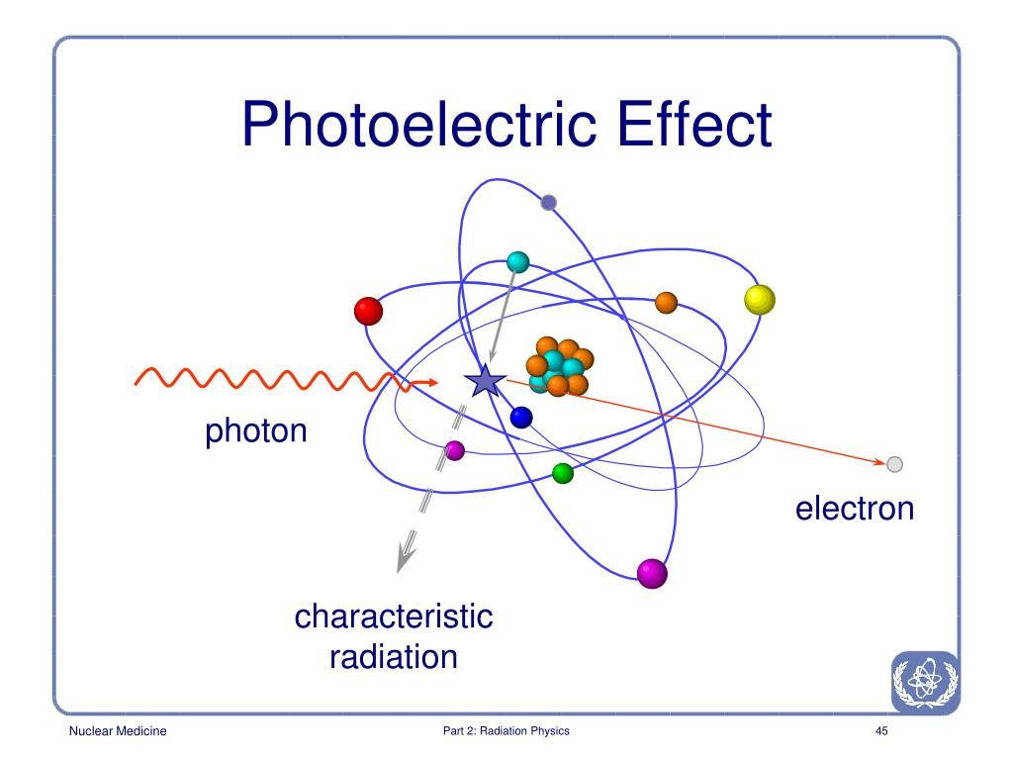
Interaction mechanisms - Photoelectric effect

Slide 8
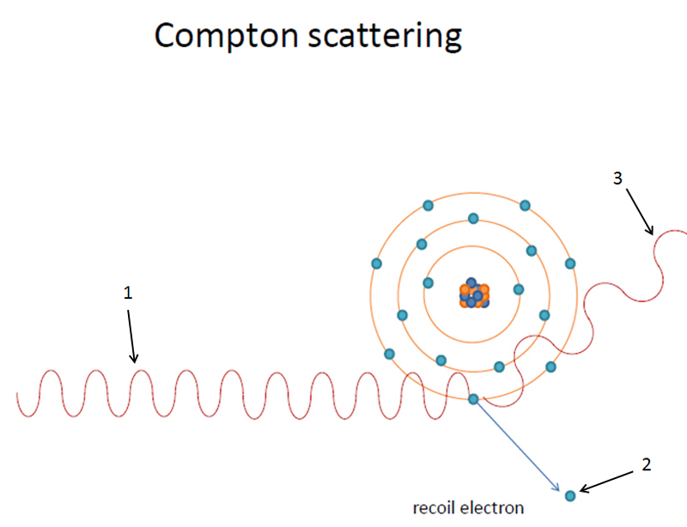
Interaction mechanisms – COMPTOM SCATTERING

Slide 9
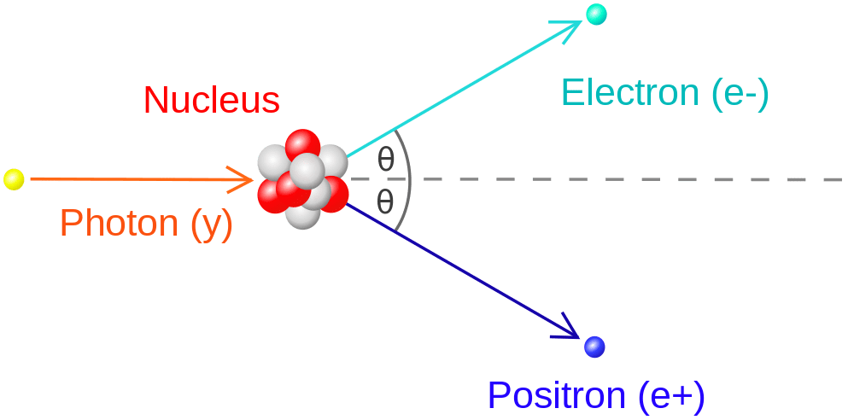
Interaction mechanisms – PAIR PRODUCTION

Slide 10
Summary of relative importance of three photon interactions

Slide 11
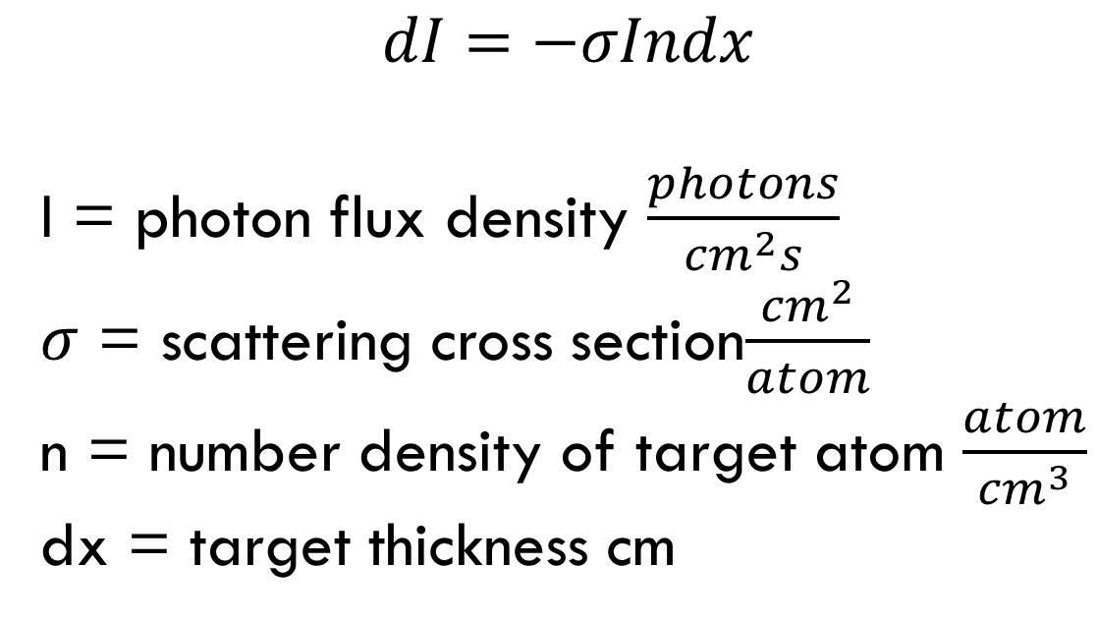
FLUX DENSITY ATTENUATION
$$dI=−σIndx$$
I = photon flux density $\frac{photons}{{cm}^{2}s}$
$σ$ = scattering cross section$\frac{{cm}^{2}}{atom}$
n = number density of target atom $\frac{atom}{{cm}^{3}}$
dx = target thickness cm

Slide 12
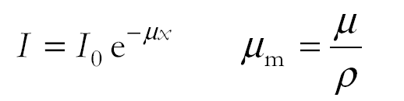
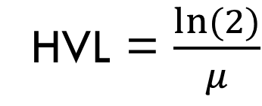

FLUX DENSITY ATTENUATION
$$dI=−σIndx$$
$$I= I_{o}e^{−nσx}$$
HVL = $\frac{ln⁡(2)}{μ}$

Slide 13
EXAMPLE 2
Determine the fraction remaining of the flux density of 1-MeV gamma rays that travel 1 and 10 cm in Lead. Assume the half value layer for 1 MeV gamma rays in Lead is 0.85 cm.

Slide 14
HOMEWORK problem 3
Determine the fraction remaining of the flux density of 10 MeV gamma rays that travel 1 and 10 cm in Lucite. Assume the half value layer for 10 MeV gamma rays in Lucite is 20 cm.

Slide 15
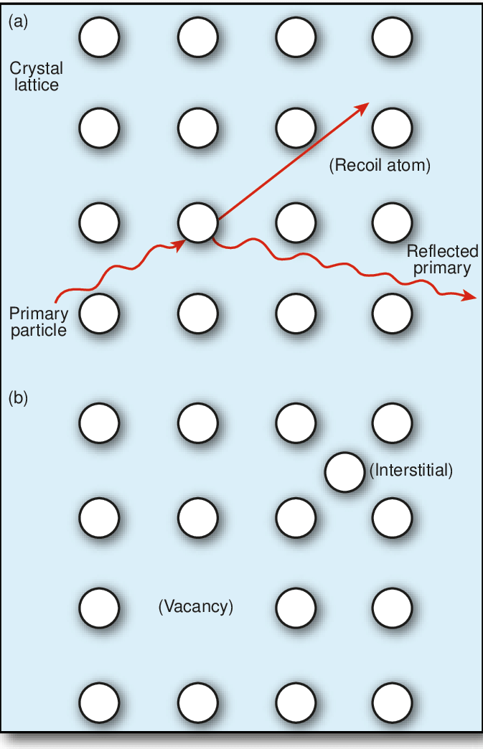
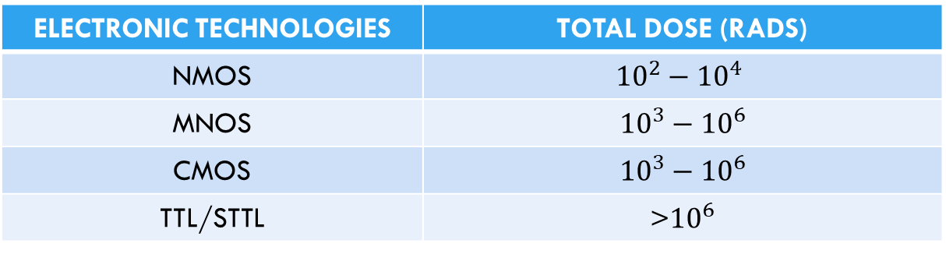
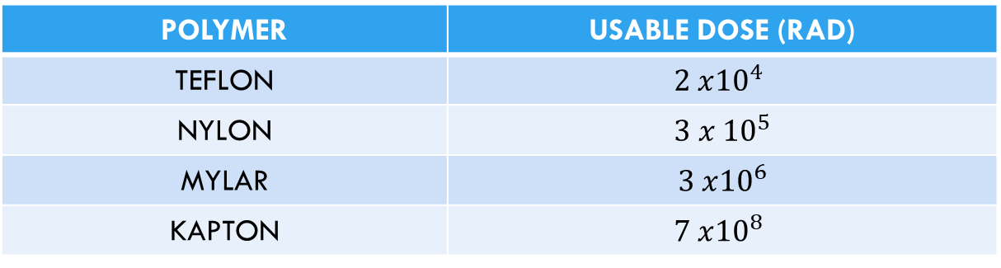
DISPLACEMENT
ELECTRONIC TECHNOLOGIES | TOTAL DOSE (RADS)
NMOS | $${10}^{2}−{10}^{4}$$
MNOS | $${10}^{3}−{10}^{6}$$
CMOS | $${10}^{3}−{10}^{6}$$
TTL/STTL | >${10}^{6}$
POLYMER | USABLE DOSE (RAD)
TEFLON | $$2 x{10}^{4}$$
NYLON | $$3 x {10}^{5}$$
MYLAR | $$3 x{10}^{6}$$
KAPTON | $$7 x{10}^{8}$$

Slide 16
Radiation Environment and Its Effects
Important effects
Degradation of electronics and materials
Can degrade mechanical, electrical and thermal properties of materials
SOLAR RADIATION PRESSURE
CAN AFFECT ADACS SYSTEM DESIGN
Single event phenomena (SEP)
Can result in upset, latchup, or burnout
Solar cell degradation is a function of time
GaAs cells are more resistant than Si, but cost more
Notes:
Energy transfer vs. charging
Energetic particles may displace or ionize material in their paths (also deposit energy to induce more low energy effects)
Dominant source depends on orbit
A variety of naturally occurring sources exist
Ionization and atomic displacement reduce the current and power that a cell can produce
Similar to solar cell degradation
No response to inputs
Functions in a manner inconsistent with its design characteristics (e.g., memory register changes state)
“soft” -- bit flips
“hard” -- permanent damage

Slide 17
Summary of Environment Effects
Notes:
To summarize, here are the environmental effects you have to consider as you investigate spacecraft orbits

Slide 18
REFERENCES
Braeunig, Robert A. (2013.) Rocket and Space Technology. Atmospheric Properties.
Cosgrove, A. (2014, September 12). Web exclusive: Potential impact of solar flares. Facility Executive. Retrieved July 10, 2022, from https://facilityexecutive.com/2013/11/web-exclusive-potential-impact-solar-flares/#:~:text=Solar%20flares%20occur%20when%20built%20up%20magnetic%20energy,When%20will%20the%20%E2%80%9Cthreat%E2%80%9D%20from%20solar%20flares%20dissipate%3F
ESA. (19 June 2017.) Magnetic Space Tug Could Target Dead Satellites.
The largest nuclear test in outer space had startling effects on Hawaii. (n.d.). Retrieved July 11, 2022, from https://www.realclearscience.com/blog/2020/01/14/the_largest_nuclear_test_in_outer_space_had_startling_effects_on_hawaii.html
Nasa Biosphere Science Research Portal. (2 June 2017.) Research Highlights Feb 2016.
Space Propulsion. (2017.) Propellant Tanks.
Tran, L. (2020, July 31). NASA Sun Data helps new model predict big solar flares. NASA. Retrieved July 10, 2022, from https://www.nasa.gov/feature/goddard/2020/nasa-sdo-sun-data-helps-new-model-predict-big-solar-flares

